Slide 1
Project Title: Stock Price Prediction Using Deep Learning
Longenus Dsilva
Department of Data Science,
Dr. Homi Bhabha State University, Mumbai400032

Slide 2
Introduction
Purpose Our project aims to predict future stock prices by leveraging deep learning models, providing valuable insights for investors and financial analysts.
Goals To enhance forecasting accuracy, we explore and compare various deep learning architectures, including Long ShortTerm Memory (LSTM), Gated Recurrent Units (GRU), and a hybrid model combining both. This study highlights the strengths of each model in capturing complex stock market patterns.

Slide 3
Why Deep Learning Over Machine Learning
Advantages of Deep Learning:
Captures Complex Patterns: Deep learning models are highly effective at identifying intricate and sequential patterns in stock data, which are essential for accurate price forecasting.
Scalability with Large Datasets: Deep learning handles large datasets efficiently, making it wellsuited for financial data where high volume and frequency are common.
Automatic Feature Extraction: Unlike traditional machine learning, deep learning automates feature extraction, saving time and enhancing accuracy by learning critical patterns directly from the data.
Why It Matters for Stock Prediction:
Deep learning’s ability to capture trends and dependencies in sequential data is crucial for stock prediction, allowing models to analyze both short-term fluctuations and longterm trends for better forecasting.

Slide 4
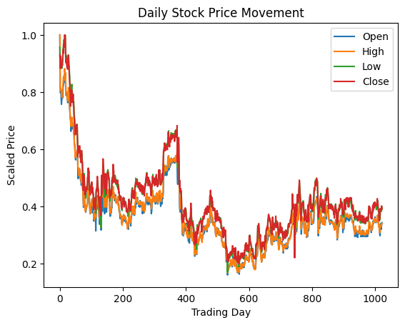
Data Description
Dataset Used: ITC / Time Frame : 15 minutes
Historical stock data with key features: Open, High, Low, Close, and prices. This data provides a comprehensive view of stock trends over time.
Data Characteristics:
Preprocessing Steps:
Scaling: All features are scaled between 0 and 1 using MinMax normalization to ensure consistent input values across the models.
Sequence Creation: Data is structured into sequences with a 60day lookback period to capture time dependencies for each prediction.
Data Splitting: The dataset is divided into training, validation, and test sets to ensure robust model training and evaluation.
This preprocessing enhances model performance by normalizing values and enabling sequential learning for stock price prediction.

Slide 5
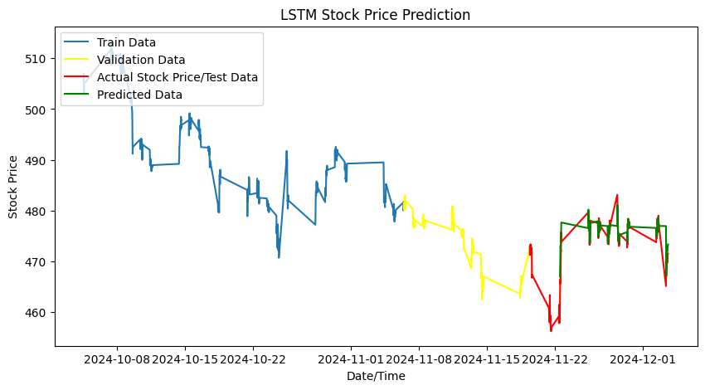
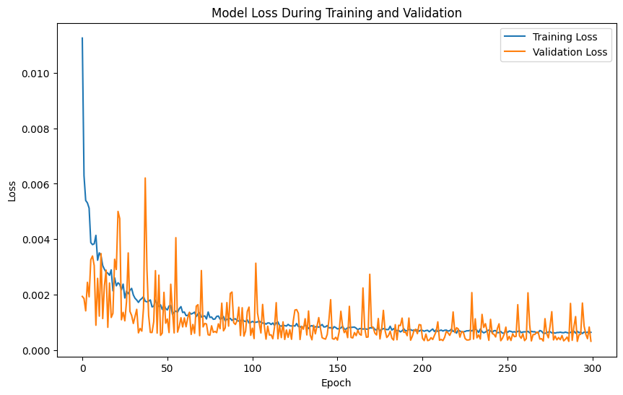
Model Description LSTM
LSTM (Long ShortTerm Memory): Captures longterm dependencies in sequential data. Dropout layers are used to prevent overfitting.
Input Shape: Sequential data with a 60day lookback to learn patterns over two months.
Optimizer: Adam, for adaptive learning rates and improved convergence.
Loss Function: Mean Squared Error (MSE) to minimize squared differences between predicted and actual values.
Accuracy Metrics:
RMSE: 0.3241
R squared: 0.8587
MSE: 0.1050
Performance: Effective in handling time series data, showing strong results in capturing longterm price trends in stock data.

Slide 6
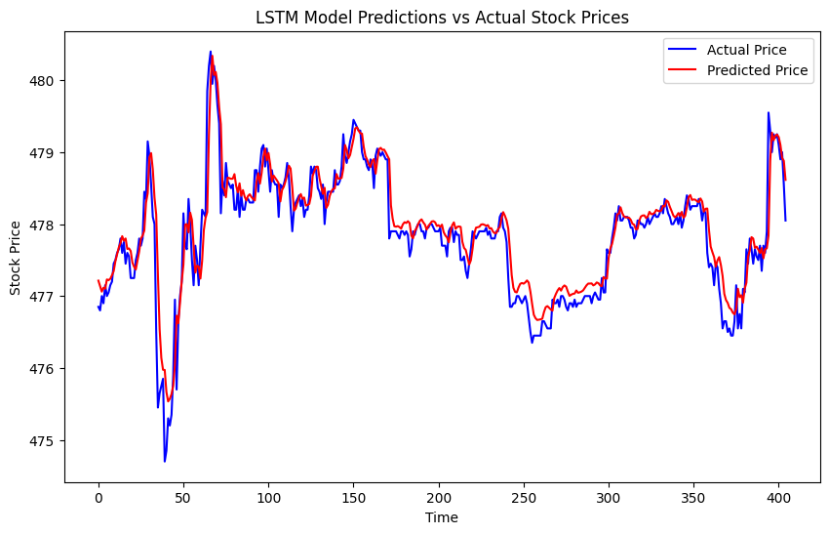
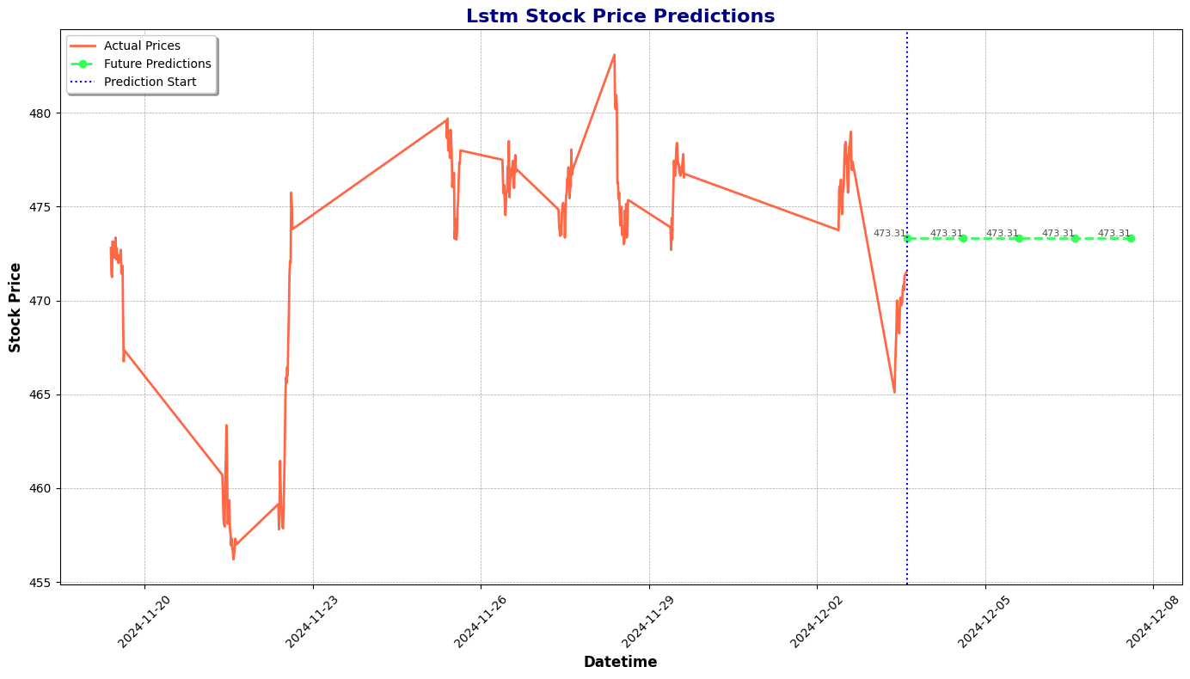
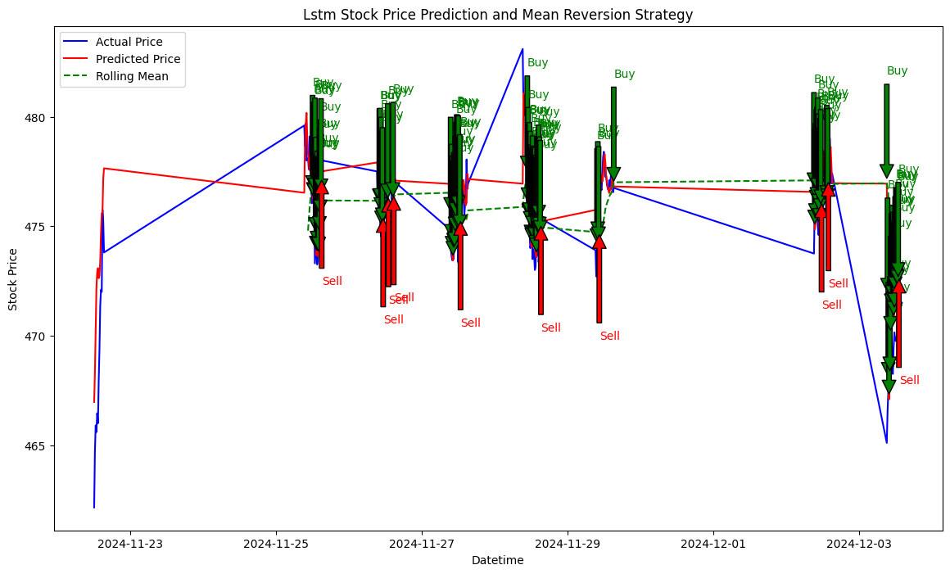
Performance Metrics:
Total No of Trades : 100
Total Profit: $-68.42
Total Returns: -0.68%
Sharpe Ratio: 0.62 Maximum Drawdown: -0.99

Slide 7
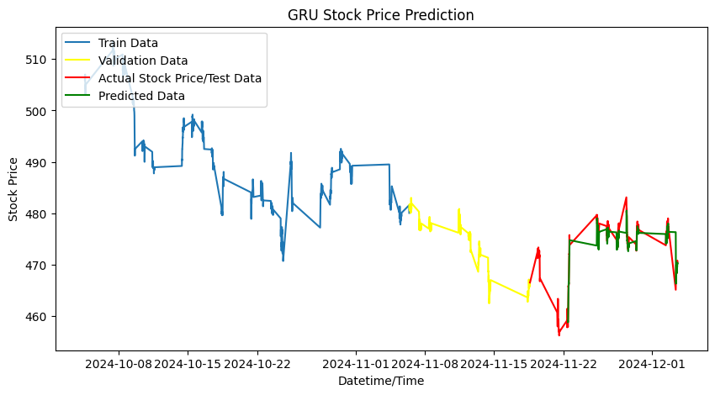
Model Description GRU
GRU (Gated Recurrent Unit): Uses a simpler gate structure than LSTM, enabling faster training. Dropout layers help reduce overfitting.
Configuration: Similar to LSTM, capturing dependencies in stock data. Efficient for short and mediumterm patterns.
Optimizer: RMSprop, suitable for stable learning in recurrent networks.
Loss Function: Mean Squared Error (MSE) to minimize squared prediction errors.
Accuracy Metrics:
RMSE: 0.1016
R-Squared: 0.8636
MSE: 0.1016
Performance: Balances simplicity and effectiveness, capturing sequential patterns with lower computational complexity.

Slide 8
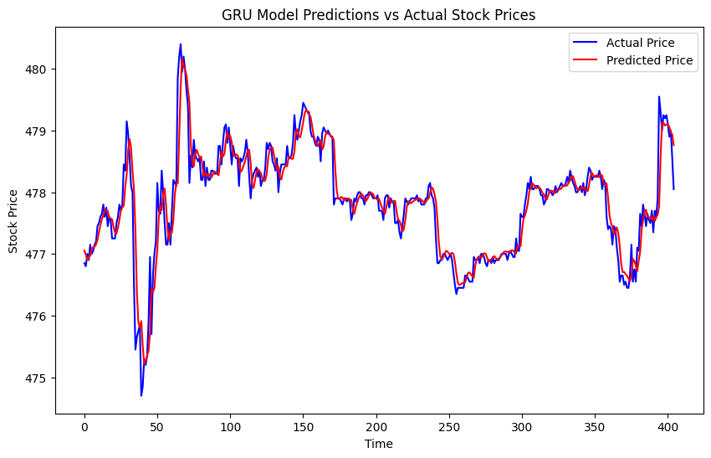
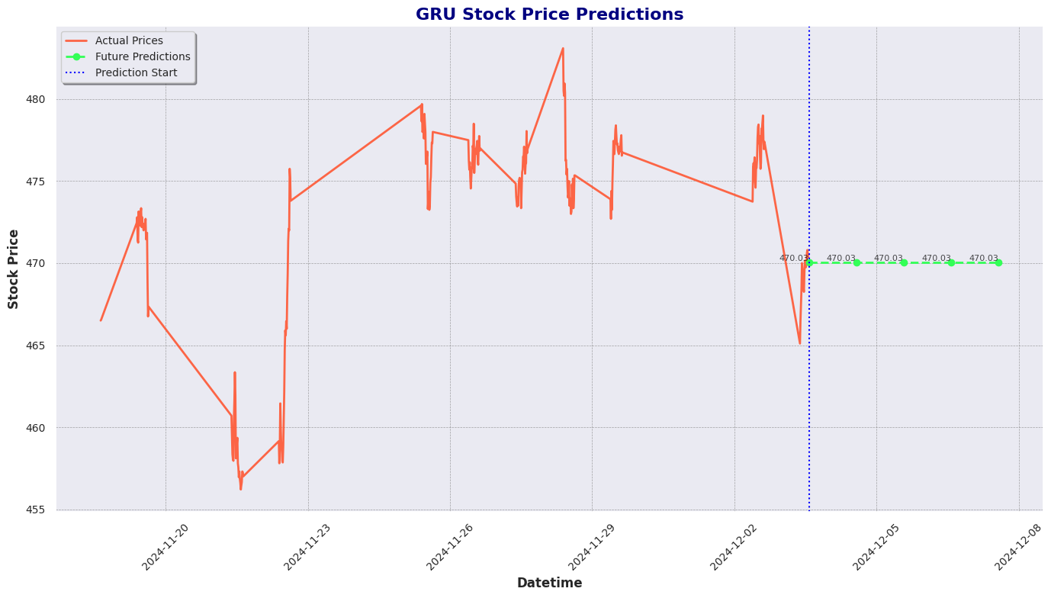
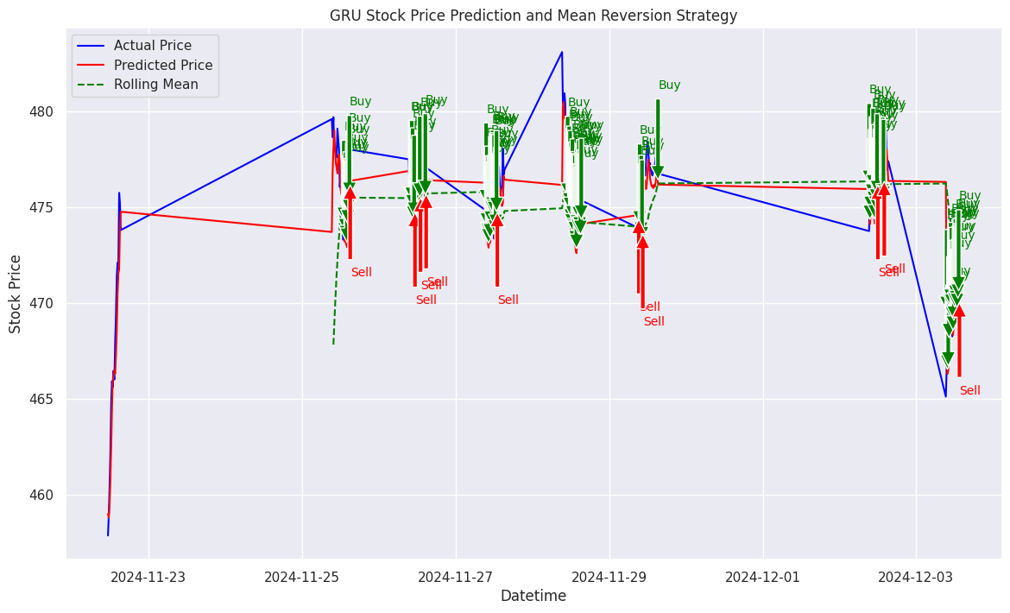
Performance Metrics:
Total No Of Trades : 100
Total Profit: $103.90
Total Returns: 1.04%
Sharpe Ratio: 1.00
Maximum Drawdown: -1.01

Slide 9
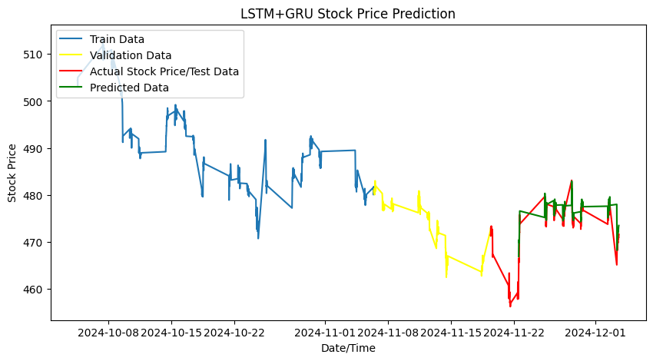
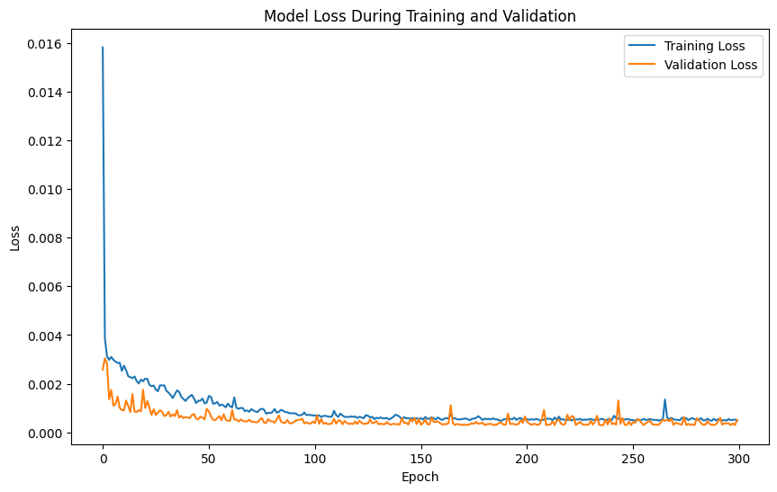
Model Description Hybrid Model (LSTM + GRU)
Combines LSTM and GRU layers for improved prediction accuracy.
LSTM captures long-term dependencies.
GRU processes shortterm dependencies for faster response.
Model Details:
LSTM Layer: First layer, learns longterm dependencies from the input data.
GRU Layer: Follows the LSTM to capture shorter-term dependencies.
Dense Layer: Final layer that produces the prediction (e.g., stock price).
Accuracy Metrics:
RMSE: 0.36166
R-Squared : 0.81862
MSE: 0.1351

Slide 10
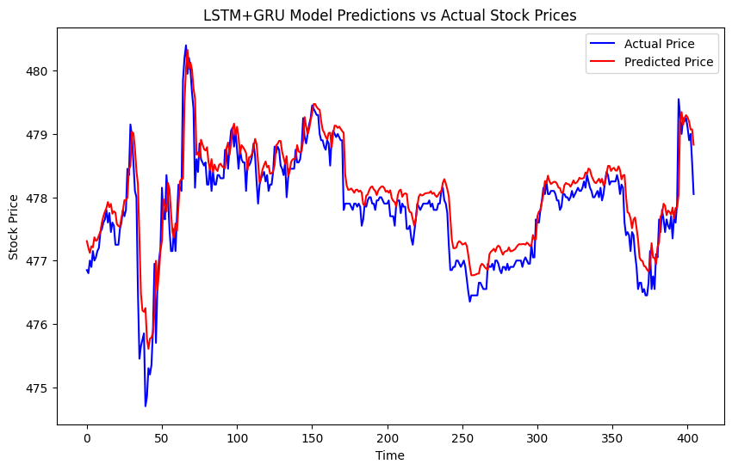
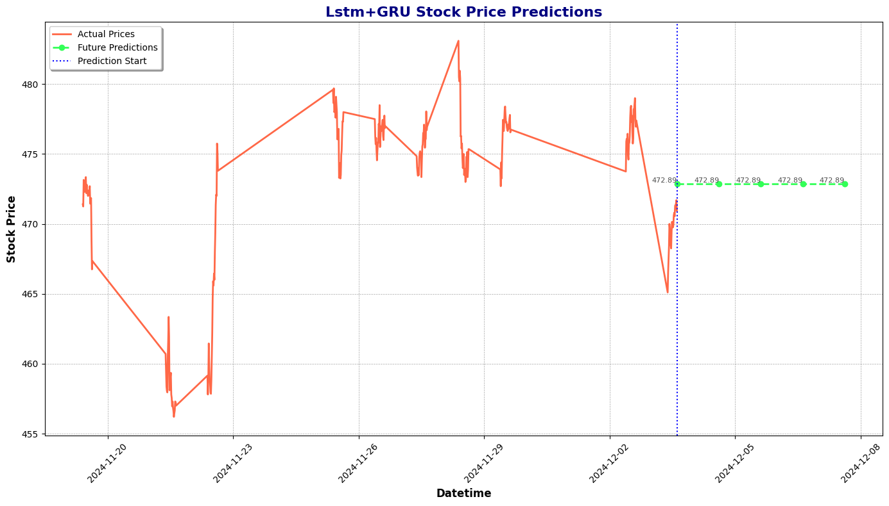
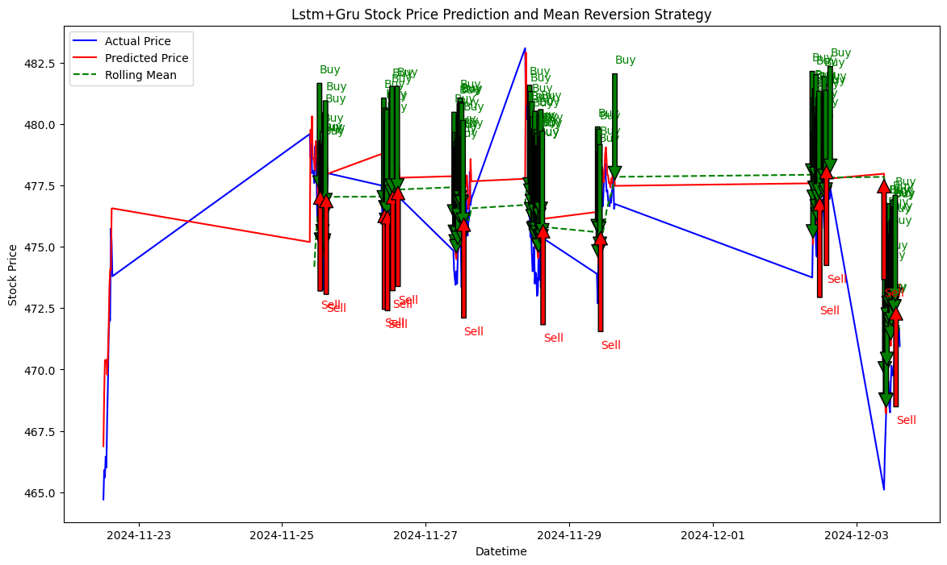
Performance Metrics:
Total No Of Trades : 100
Total Profit: $209.44
Total Returns: 2.09%
Sharpe Ratio: 0.51
Maximum Drawdown: -1.02

Slide 11
Total No Of Trades : 100
Model | R-Squared | Strengths | Weaknesses | Total Profit | Total Returns | Sharpe Ratio | Maximum Drawdown
LSTM | 0.8587 | Strong at capturing long-term dependencies | Longer training time, higher computational cost | $-68.42 | -0.68% | 0.62 | -0.99
GRU | 0.8636 | Faster training, good for short-to-medium dependencies | Less effective with long-term dependencies | $103.90 | 1.04% | 1.00 | -1.01
Hybrid | 0.81862 | Combines LSTM and GRU strengths, achieves better accuracy | Higher complexity than GRU | $209.44 | 2.09% | 0.51 | -1.02

Slide 12
Results:
Best Model: The hybrid model outperformed both LSTM and GRU across key metrics (MSE, RMSE, MAE), effectively combining the strengths of both models.
Model Accuracy: The hybrid model showed the lowest error rates, indicating more accurate stock price predictions.
Performance Comparison: While LSTM captured long-term dependencies well, and GRU excelled in efficiency and convergence speed, the hybrid model balanced both effectively.
Observations on Overfitting: The hybrid model demonstrated lower risk of overfitting due to its combined architecture and regularization techniques.

Slide 13
Conclusion:
Hybrid Model Advantage: By leveraging LSTM’s long-term dependency capture and GRU’s faster convergence, the hybrid model achieved improved accuracy, making it a strong candidate for stock price forecasting.
Model Flexibility: The hybrid model adapts well to various patterns in stock data, making it suitable for both short- and long-term predictions.
Real-World Application: This hybrid approach could be highly applicable for financial analysts and traders who require precise predictions for effective decision-making.
Future Scope: Further improvements can explore optimized configurations of the hybrid model or test it on other financial datasets for broader application.

Slide 14
Thank You …

